Slide 1
Functions
CSE 2213/CSI 219 – Discrete Mathematics

Slide 2
Function
Let A and B be nonempty sets. A function f from set A to set B is the mapping of every element of A to a single element of B.
We write f(a) = b if the function named f maps the value of a (a belongs to Set A) to a value of b (b belongs to Set B).
The above notation is the “Value Notation” of writing functions
If f is a function from set A to set B, we write
f:A→B.
The above notation is the “Set Notation” of writing functions.

Slide 3
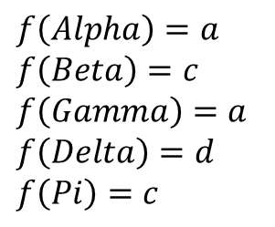

Function
Alpha
Beta
Gamma
Delta
Pi
a
b
c
d
e
$$f:A→B$$
$$f\left(Alpha\right)=a$$
$f\left(Beta\right)=c$
$f\left(Gamma\right)=a$
$f\left(Delta\right)=d$
$f\left(Pi\right)=c$
A
B

Slide 4
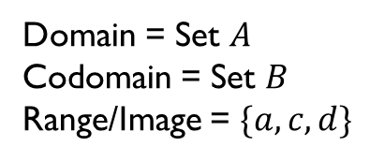
Function
Alpha
Beta
Gamma
Delta
Pi
a
b
c
d
e
$$f:A→B$$
Domain = Set $A$
Codomain = Set $B$
Range/Image = $\{a,c,d\}$
A
B

Slide 5
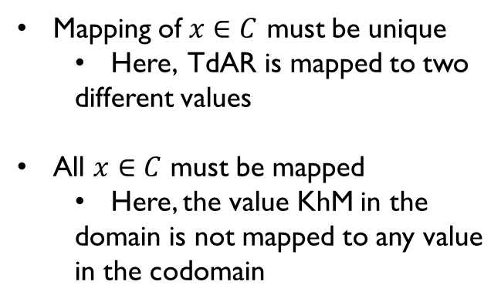

Not a function
MiBa
TdAR
KBJ
SyS
KhM
A
B
C
D
E
$$f:C→B$$
Mapping of $x∈C$ must be unique
Here, TdAR is mapped to two
different values
All $x∈C$ must be mapped
Here, the value KhM in the
domain is not mapped to any value
in the codomain
C
B

Slide 6
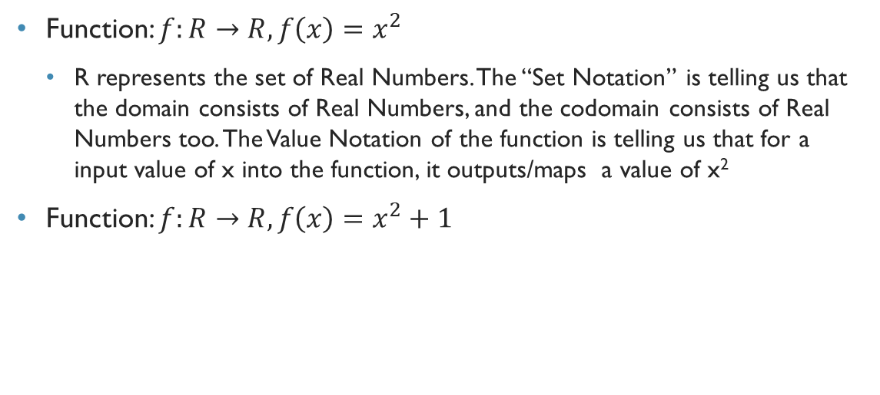
Mathematical example
Function: $f:R→R,f\left(x\right)=x^{2}$
R represents the set of Real Numbers. The “Set Notation” is telling us that the domain consists of Real Numbers, and the codomain consists of Real Numbers too. The Value Notation of the function is telling us that for a input value of x into the function, it outputs/maps a value of x²
Function: $f:R→R,f\left(x\right)=x^{2}+1$

Slide 7
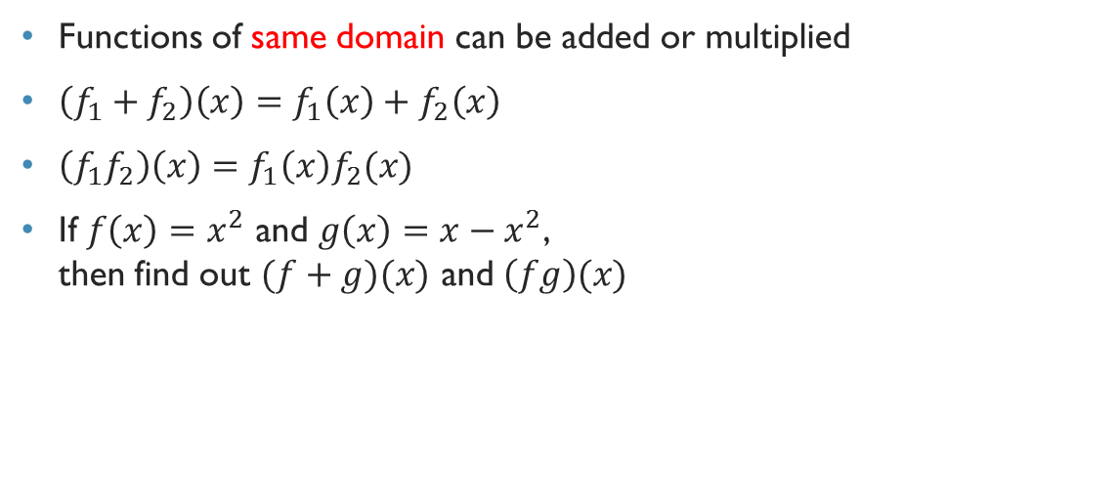
Addition and multiplication of function
Functions of same domain can be added or multiplied
$\left(f_{1}+f_{2}\right)\left(x\right)=f_{1}\left(x\right)+f_{2}\left(x\right)$
$\left(f_{1}f_{2}\right)\left(x\right)=f_{1}\left(x\right)f_{2}(x)$
If $f\left(x\right)=x^{2}$ and $g\left(x\right)=x−x^{2}$, then find out $(f+g)(x)$ and $\left(fg\right)(x)$

Slide 8
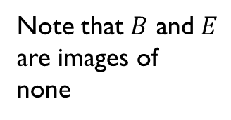
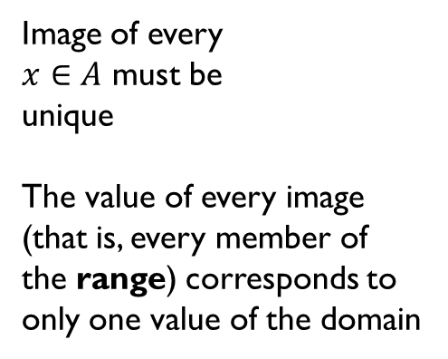

One-to-one Function or Injection
Alpha
Beta
Delta
A
B
C
D
E
Image of every
$x∈A$ must be
unique
The value of every image
(that is, every member of
the range) corresponds to
only one value of the domain
Note that $B$ and $E$
are images of
none
A
B

Slide 9
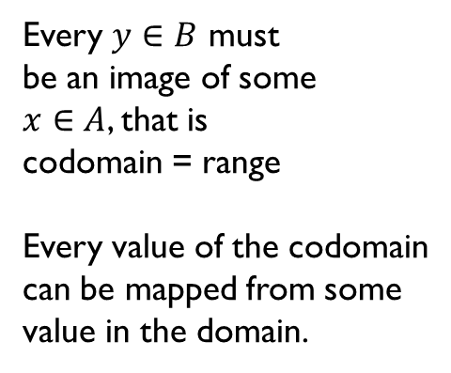
Onto Function or Surjection
Every $y∈B$ must
be an image of some
$x∈A$, that is
codomain = range
Every value of the codomain
can be mapped from some
value in the domain.
Alpha
Beta
Gamma
Delta
A
C
D
Note that Alpha and
gamma have the
same image. This violates the
one-to-one property. This is
therefore, not a one-to-one
function.
A
B

Slide 10
Bijection
Alpha
Beta
Delta
A
C
D
Function that is
both one-to-one
and onto
A
B

Slide 11

Problem
Find out if the function $f:Z→Z,f\left(x\right)=x^{2}$ is one-to-one and/or onto.
Find out if the function $f:R→R,f\left(x\right)=x+1$ is one-to-one and/or onto.

Slide 12
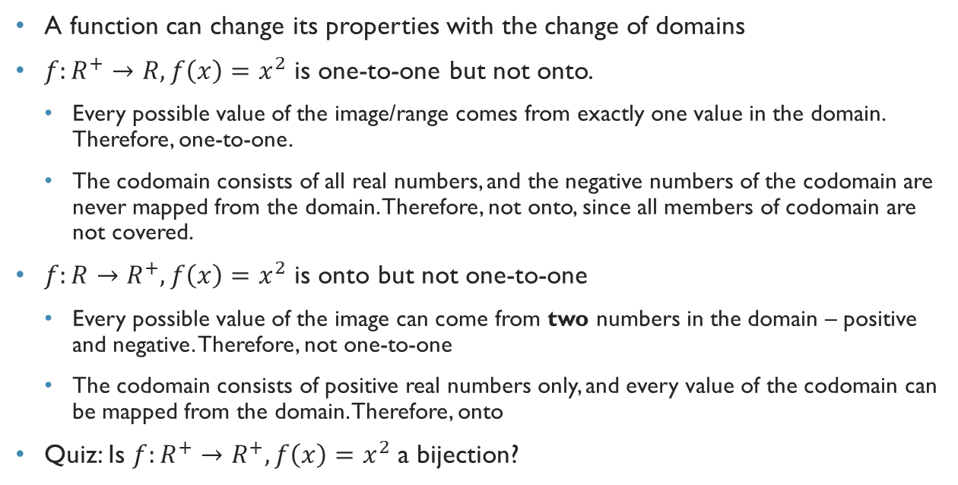
One-to-one and onto functions
A function can change its properties with the change of domains
$f:R^{+}→R,f\left(x\right)=x^{2}$ is one-to-one but not onto.
Every possible value of the image/range comes from exactly one value in the domain. Therefore, one-to-one.
The codomain consists of all real numbers, and the negative numbers of the codomain are never mapped from the domain. Therefore, not onto, since all members of codomain are not covered.
$f:R→R^{+},f\left(x\right)=x^{2}$ is onto but not one-to-one
Every possible value of the image can come from two numbers in the domain – positive and negative. Therefore, not one-to-one
The codomain consists of positive real numbers only, and every value of the codomain can be mapped from the domain. Therefore, onto
Quiz: Is $f:R^{+}→R^{+},f\left(x\right)=x^{2}$ a bijection?

Slide 13

Inverse of functions
Inverse of a function exists if the function is a bijection
Called an invertible function
Notes:
Go to a previous bijection function to explain this before reading out the definition.

Slide 14
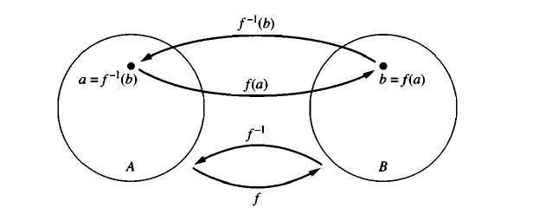
Example

Slide 15


EXample
. f:A $→$B
Alpha
Beta
Gamma
Delta
Pi
A
B
C
D
E
$f\left(Alpha\right)=A$
$f\left(Beta\right)=C$
$f\left(Gamma\right)=A$
$f\left(Delta\right)=D$
$f\left(Pi\right)=C$
$f^{−1}$(A)= ???
$f^{−1}$(C)=
$f^{−1}$(D)=
$f^{−1}$(B)= ???
A
B

Slide 16
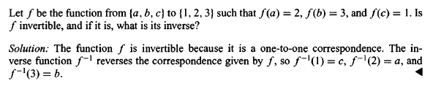
Example

Slide 17
Example

Slide 18
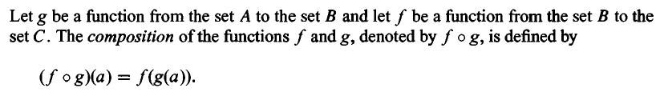
The composition of a function

Slide 19
Example
Let f and g be the functions from the set of integers to the set of integers defined by f(x) =2x + 3 and g(x) = 3x + 2. What is the composition of f and g? What is the composition of g and f ?
f o g(x)=f(g(x))=f(3x+2)=2(3x+2)+3=6x+7
g o f(x)=g(f(x))=g(2x+3)=3(2x+3)+2=6x+11

Slide 20
Example
Let g be the function from the set {a, b, c} to itself such that g(a) = b, g(b) = c, and g(c) = a. Let f be the function from the set {a, b, c} to the set {I, 2, 3} such that f(a) = 3, f(b) = 2, and f(c) = l. What is the composition of f and g, and what is the composition of g and f?

